Slide 1
MATH221 Mathematics for Computer Science
Unit 6
Elementary Number Theory
1

Slide 2
OBJECTIVES
Understand the definition of divisibility.
Understand apply the Quotient-Remainder Theorem.
Understand and be able to find the Greatest Common Divisor.
Understand and apply the Euclidean Algorithm.
Understand the concept of the Fundamental Theorem of Arithmetic.
2

Slide 3
Divisibility
If n and d are integers and d ≠ 0, then n is divisible by d if and only if
n = d × k for some k ∈ ℤ.
We write d | n and say that d divides n (n is divisible by d).
In logic notation, the definition of divisibility is written
d | n ⇔ ∃k ∈ ℤ, n = dk.
3

Slide 4
Divisibility
Alternatively, if
d | n ⇔ ∃k ∈ ℤ, n = dk.
We say that
n is divisible by d, or
d divides n, or
n is a multiple of d, or
d is a factor of n, or
d is a divisor of n.
4

Slide 5
Discussion:
1. Is -16 a divisor of 32?
Yes.
32 = -16 × -2.
2. If l ∈ ℤ and l ≠ 0, does l | 0?
Yes.
0 = l × 0 for some 0 ∈ ℤ.
5

Slide 6
Discussion:
3. If a , b ∈ ℤ, is 3a + 3b divisible by 3?
Now, 3a + 3b = 3(a + b)
= 3s
where s = a + b and s ∈ ℤ.
Hence, 3 | 3a + 3b, that is, 3a + 3b is divisible by 3.
6

Slide 7
Discussion:
4. If a , b, c, x, y ∈ ℤ. If b | a and b | c, does b | (ax + cy)? Why?
Now, b | a ⇔ ∃k ∈ ℤ, a = bk (1)
b | c ⇔ ∃l ∈ ℤ, c = bl (2)
(1) × x, ax = bkx (3)
(2) × y, cy = bly (4)
(3) + (4), ax + cy = bkx + bly
= b(kx + ly)
= bm where m = kx + ly, m ∈ ℤ.
Hence, b | (ax + cy).
7

Slide 8
Discussion:
5. If a, b ∈ ℕ, is it true that a | b implies a ≤ b?
Now, a | b ⇒ ∃k ∈ ℤ, b = ak.
Since a , b ≥ 1, so k ≥ 1.
Multiply both sides of the inequality by a,
ka ≥ 1a.
Hence, b ≥ a.
That is, a ≤ b
Therefore, if a , b ∈ ℕ, it is true that a | b implies a ≤ b.
8

Slide 9
Theorem - Transitivity of Divisibility
For all integers a, b and c, if a | b and b | c, then a | c.
Note: After going through the details of the proof for this theorem, for the remaining theorems, lemma, etc., we shall focus on the application.
9

Slide 10
Transitivity of Divisibility: Proof
We know that
a | b ⇒ ∃k ∈ ℤ, b = ak (1)
b | c ⇒ ∃l ∈ ℤ, c = bl (2)
Show that a | c, that is, find m ∈ ℤ such that c = ma.
Now, c = bl by (2)
= (ak)l by (1)
= (kl)a by associativity and commutativity
Let m = kl, then m ∈ ℤ. Therefore, c = ma and so a | c.
10

Slide 11
Theorem - Divisible by a Prime
Theorem:
Every integer n ≥ 2 is divisible by some prime number.
11
Notes:
k is divisible by some prime number.
Since 2<r<k, r is divisible by some prime number, ie. p|r.
Since p|r and r|(k+1), so p|(k+1).

Slide 12
Theorem – Infinite Primes
Theorem:
There are infinitely many primes.
12

Slide 13
The Quotient-Remainder Theorem
If n ∈ ℤ and d ∈ ℕ, then there exist unique integers q and r such that
n = dq + r and 0 ≤ r < d.
The theorem says that when we divide any integer n by any positive integer d, there will be a unique quotient q and remainder r satisfying 0 ≤ r < d.
13

Slide 14
The Quotient-Remainder Theorem: Note
Note that the theorem makes two assertions:
1. Existence: There exists q, r ∈ ℤ such that
n = dq + r and 0 ≤ r < d.
2. Uniqueness: There is only one pair of values of q and r with these properties.
14

Slide 15
The Quotient-Remainder Theorem: Note
The Quotient-Remainder Theorem says that when we divide any integer n by any positive integer d, there will be a quotient q and a remainder r, where 0 ≤ r < d.
Example.
Let n = 11, d = 4.
Then we have 11 = 4 × 2 + 3;
That is, q = 2 and r = 3.
15

Slide 16
Exercise:
Find values for q, r ∈ ℤ such that n = d × q + r, 0 ≤ r < d, for the following.
(i) n = 54, d = 4
For positive n, a positive quotient q is multiplied to the divisor d to obtain a number slightly smaller than n.
Then the nonnegative integer r is then added to the product (d × q) to make it equal to n.
That is,
54 = 4 × 13 + 2.
Hence, q = 13, r = 2.
16

Slide 17
Exercise:
(ii) n = -54, d = 4
Follow the following steps (3 steps):
Step 1: as per basic division to divide 54 by 4:
We get quotient = 13 and remainder = 2
Step 2: change the above quotient to negative number and subtract 1 from it, we get:
The required quotient = -13 - 1 = -14
Step 3: Find the required remainder:
-54 = 4 x(-14) + r
r = -54 + 56 = 2
We get the expression according quotient-remainder theorem as:
-54 = 4 × (-14) + 2.
Note:
-54 = 4× (-13) + (-2)
X (the remainder must be 0 ≤ r < 4
17

Slide 18
Exercise:
(iii) n = 54, d = 70
Now, 54 = 70 × 0 + 54.
Hence, q = 0, r = 54.
Can you find a second set of q and r (r < d)?
No. The Quotient-Remainder Theorem says that q and r are unique, that is, there is only one solution for q and r in the previous exercise.
18

Slide 19
Theorem – Classification of Integer
Theorem:
Every Integer is either Odd or Even.
19

Slide 20
Greatest Common Divisor
Let a, b ∈ ℤ with a ≠ 0 or b ≠ 0. A natural number c is said to be the greatest common divisor (gcd) of a and b if and only if
(i) c | a and c | b; and
(ii) if d | a and d | b for some d ∈ ℕ, then d | c.
We write gcd(a, b) = c.
20

Slide 21
Exercise:
1. Evaluate gcd(18, 12), gcd(18, -12), gcd(-18, 12)
and gcd(-18, -12).
Common divisors: -6, -3, -2, -1, 1, 2, 3, 6
For all the above the greatest common divisor is 6.
2. What can you say about gcd(a, b); gcd (a, -b); gcd(-a, b); gcd(-a, -b)?
All have the same value.
3. Evaluate gcd(7, 11).
1.
21

Slide 22
Exercise:
4. For a, b ∈ ℤ where not both are zero, does gcd(a, b) always exist? Is it unique?
Yes, it will always exist.
Yes.
For example, gcd(4, 0) = 4 and gcd(0, -3) = 3.
22

Slide 23
Lemmas
Lemma 1:
If r is a positive integer, then gcd(r, 0) = r.
Lemma 2:
If a, b ∈ ℤ with b ≥ 1, and if q and r are integers such that
a = b × q + r, then gcd(a, b) = gcd(b, r).
23

Slide 24
The Euclidean Algorithm
The Euclidean Algorithm is a process for finding the greatest common divisor between two integers.
It is structured according to the following steps:
1. Let A and B be integers with A > B ≥ 0.
If B = 0, then gcd(A, B) = A.
2. If B > 0, then the quotient-remainder theorem can be used to divide A by B to obtain a quotient q and a remainder r:
A = Bq + r where 0 ≤ r < B.
Hence, gcd(A, B) = gcd(B, r).
3. If r =0, then gcd(B, r) = B, otherwise, repeat Step 2, with A and B substituted with B and r respectively.
The repetitions are guaranteed to terminate eventually with r = 0.
24

Slide 25
The Euclidean Algorithm: Example
Evaluate gcd(2772, 2310).
First iteration of Step 2:
Divide 2772 by 2310:
2772 = 2310 × 1 + 462
gcd(2772, 2310) = gcd(2310, 462)
Second iteration of Step 2:
Divide 2310 by 462:
2310 = 462 × 5 + 0
gcd(2310, 462) = gcd(462, 0)
Since gcd(462, 0) = 462, hence, gcd(2772, 2310) = 462.
So altogether, 2 iterations of Step 2 to find gcd(2772, 2310).
25

Slide 26
Relatively Prime
If a, b ∈ ℤ and gcd(a, b) = 1, then a and b are relatively prime.
Example:
Since gcd(17, 9) = 1.
Hence, we say that 17 and 9 are relatively prime.
26

Slide 27
Theorem on Linear Combination of gcd
If a, b ∈ ℤ and not both equal zero, then gcd(a, b) exists and there exist m, n ∈ ℤ such that gcd(a, b) = ma + nb.
27

Slide 28
Theorem on Linear Combination of gcd: Notes
1. The theorem says two things.
(i) gcd(a, b) always exists as long as both a and b are not both zero; and
(ii) gcd(a, b) can be written as a linear combination of a and b.
2. The proof to this theorem is similar to that of the Quotient-Remainder Theorem. The proof is not examinable.
28

Slide 29
How to find Linear Combination of gcd?
1. Use Euclidean Algorithm to find the gcd step-by-step and write down the expression resulted from applying quotient-remainder theorem in each step.
2. Work backwards systematically as shown in the next slide to get the linear combination of gcd.
29

Slide 30
Find Linear Combination of gcd: Example
Finding linear combination of gcd for 7854 and 2772.
Using Euclidean Algo, we compute gcd(7854, 2772) as follows:
7854 = 2772 × 2 + 2310 ------- (1)
2772 = 2310 × 1 + 462 -------(2)
2310 = 462 × 5 + 0
Hence, gcd(7854, 2772) = gcd(2772, 2310) = gcd(462, 0) = 462
(1) ⇒ 2310 = 7854 - 2772 × 2 --------(3)
(2) ⇒ 462 = 2772 - 2310 × 1 --------(4)
Work backwards from (4), we get:
462 = 2772 - 2310 × 1 (from (4))
= 2772 – (7854 - 2772 × 2) ×1 (from (3))
= 7854 × (-1) + 2772 × 3
= (-1) × 7854 + 3 × 2772
Hence, the linear combination of gcd for 7854 and 2772 is:
462 = (-1) × 7854 + 3 × 2772
Note:
2772 – (7854 - 2772 × 2) ×1
= 2772 – 7854 + 2772 × 2 × 1
= – 7854 + 2772 + 2772 × 2
= – 7854 + 2772 × (1 +2)
= – 7854 + 2772 × 3
= (–1) × 7854 + 3 × 2772
30

Slide 31
Corollaries
Corollary 1:
If a, b are relatively prime, then ∃m, n ∈ ℤ such that
1 = ma + nb.
Corollary 2:
Let a, b, c ∈ ℤ.
If gcd(a, b) = 1 and a | bc, then a | c.
31

Slide 32
Euclid’s Lemma
Let p be a prime and a, b ∈ N. If p | ab, then p | a or p | b.
32

Slide 33
Exercise:
1. Write the following numbers in terms of their prime factors.
32
= 16 × 2
= 8 × 2 × 2
= 4 × 2 × 2 × 2
= 2 × 2 × 2 × 2 × 2
33

Slide 34
Exercise:
2. Write the following numbers in terms of their prime factors.
924
= 462 × 2
= 231 × 2 × 2
= 77 × 3 × 2 × 2
= 11 × 7 × 3 × 2 × 2
34

Slide 35
Exercise:
3. Are these factorization unique? How do you know?
Yes.
The Fundamental Theorem of Arithmetic states that
each integer greater than 1 can be decomposed into prime factors – and this decomposition is the only one.
4. Can you express EVERY natural number as a product of primes?
No, since 1 is not prime.
Note (def of prime from Unit 3):
An integer n > 1 is prime if whenever n = r × s for positive integers r and s , we have r = 1 or s = 1.
35

Slide 36
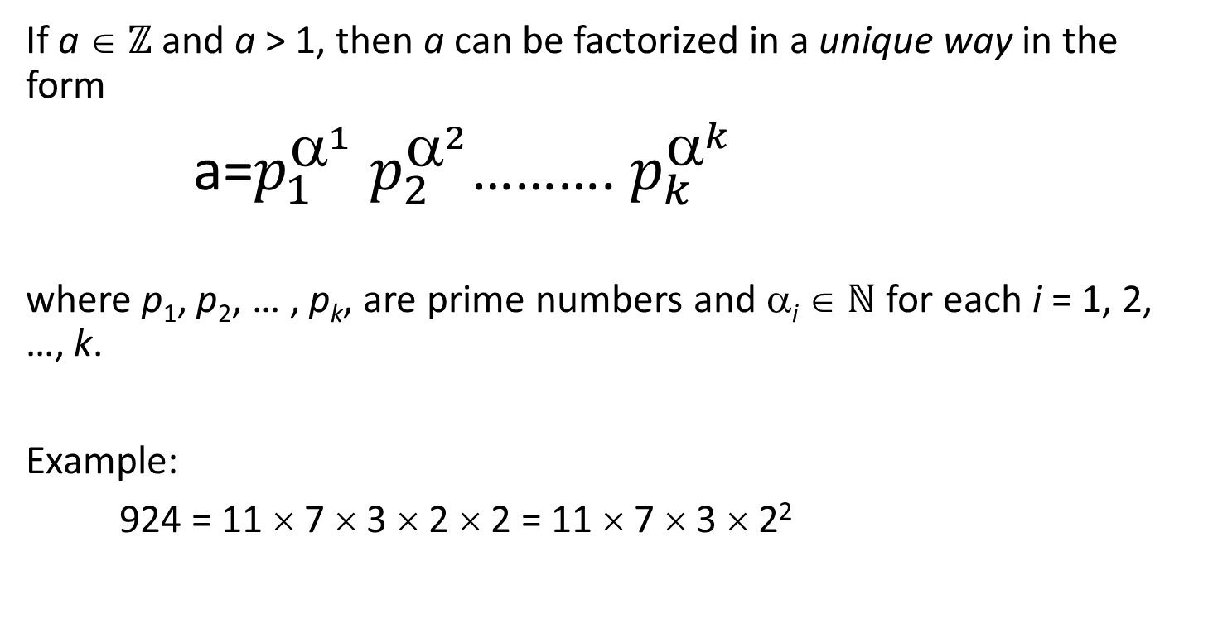
The Fundamental Theorem of Arithmetic
If a ∈ ℤ and a > 1, then a can be factorized in a unique way in the form
a=$p_{1}^{^{1}}$ $p_{2}^{^{2}}$………. $p_{k}^{^{k}}$
where p₁, p₂, … , p_{k}, are prime numbers and α_{i} ∈ ℕ for each i = 1, 2, …, k.
Example:
924 = 11 × 7 × 3 × 2 × 2 = 11 × 7 × 3 × 2²
36

Slide 37
Finding Prime Numbers
The easiest method to find prime numbers up to n is to use the Sieve of Eratosthenes algorithm.
37

Slide 38
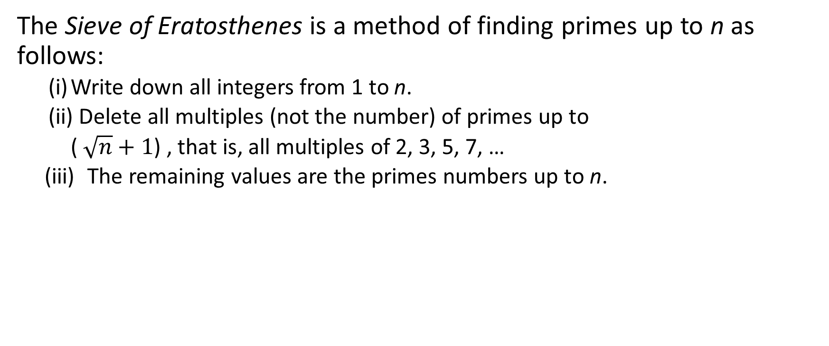
Sieve of Eratosthenes Algorithm
The Sieve of Eratosthenes is a method of finding primes up to n as follows:
(i) Write down all integers from 1 to n.
(ii) Delete all multiples (not the number) of primes up to
( $\sqrt{n}+1$) , that is, all multiples of 2, 3, 5, 7, …
(iii) The remaining values are the primes numbers up to n.
38

Slide 39
Exercise: Find all primes between 1 and 100.
X
X
X
X
X
1 2 3 4 5 6 7 8 9 10
11 12 13 14 15 16 17 18 19 20
21 22 23 24 25 26 27 28 29 30
31 32 33 34 35 36 37 38 39 40
41 42 43 44 45 46 47 48 49 50
51 52 53 54 55 56 57 58 59 60
61 62 63 64 65 66 67 68 69 70
71 72 73 74 75 76 77 78 79 80
81 82 83 84 85 86 87 88 89 90
91 92 93 94 95 96 97 98 99 100
X
X
X
X
X
X
X
X
X
X
X
X
X
X
X
X
X
X
X
X
X
X
X
X
39

Slide 40
Finding Prime Factorization – an Example
Finding Prime Factorization for 100 (that is to find ALL the prime factors of 100):
We use Sieve of Eratosthenes to find all the smallest prime numbers up a certain number to try. For our purpose, these prime numbers are 2, 3, 5, 7, 11.
Then, we start trying from 2, we find that divide 100 is divisible by 2, and the quotient = 50.
Next, we find that 50 is divisible by 2 again, and the quotient = 25.
Now, we find that 25 is not divisible by 2 again, so we try the next prime number 3, and we find that 25 is also not divisible by 3. Hence, we try the next prime number after 3, that is 5. We find that 25 is divisible by 5, and the quotient = 5.
Since the last quotient 5 is itself is a prime number, so we stop.
Therefore, 100 = 2 x 2 x 5 x 5.
100
2
50
2
25
5
5
40

Slide 41
Least Common Multiples
S
Let a, b ∈ Z be two nonzero integers. The least common multiple of a and b, denoted lcm(a, b), is the positive number c with the properties:
c is a common multiple of a and b; that is, a | c and b | c.
If d is a common multiple of a and b, then c ≤ d .
Examples: lcm(18, 12) = 36
lcm(18, 15) = 90
41

Slide 42
Least Common Multiples
S
We can use prime factorisations to calculate the lcm. Suppose
a = p^{α1} p^{α2} . . . p^{αk} and b = p^{β1} p^{β2} . . . p^{βk}
1 2 k 1 2 k
Then
lcm(a, b) =a = p₁^{γ1} p₂^{γ2} . . . p_{k}^{γk} where
where γ_{i =} α_{i} , if α_{i} ≥ β_{i}
γ_{i =} β_{i} , otherwise
42

Slide 43
S
Calculating Least Common Multiples: Examples
Given that 3220 = 2² × 5 × 7 × 23 and 1155 = 3 × 5 × 7 × 11, we have
lcm(3220, 1155) = 2² × 3 × 5 × 7 × 11 × 23
Given that 35100 = 2² × 3³ × 5² × 13 and 6975 = 3² × 5² × 31, we have
lcm(35100, 6975) = 2² × 3³ × 5² × 13 × 31
43

Slide 44
End of Unit 6
44

